Slide 1
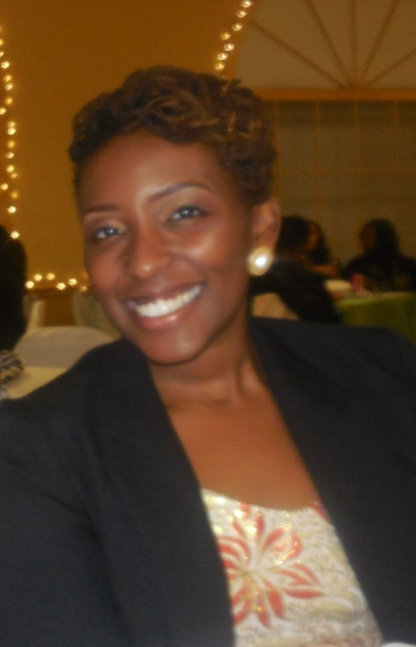
Summer Internship/Employment Opportunities 101 Webinar Sunday, February 9, 2014 5:00pm EST
Cecelela Tomi
Achievement Fellow at Higher Achievement
UPenn ‘13

Slide 2

Outline
Why it’s Important
Basic Tips
Programs/Opportunities by Field:
STEM
Business
Humanities/Arts
Study Abroad
Application Process
Deadlines/Costs
Non-Professional Opportunities
Job Shadowing

Slide 3
Why it’s Important
Experience:
Gain years’ worth of experience in weeks
Develop work ethics
Marketability
Employers want employees who have experience
Mentorship
New relationships and guidance
Clarity
New experiences help to define your niche
Income
Generate personal funds
Notes:
New connections for life

Slide 4
Basic Tips
Start early!
Prepare necessary documents early:
Resume
Working permits
Driver’s license/ State ID
Visa/passport
Ask for references (teachers, supervisors)
Use your resources (school, friends, etc.)
Notes:
Best opportunities have early deadlines
Be proactive
Working permit (depending on immigration status, state laws, age, etc.)
Collect business cards/contact information for teachers/professors

Slide 5
Programs/Opportunities: STEM (Science, Technology, Engineering, Math) & Healthcare
Middle School:
NSBE SEEK Camp
Free 3-week day camp for students grades 3-8
Deadline: February 10, 2014
High School:
Summer & Weekend Camps for Girls (database)
Career Cornerstone Center: Pre-College Summer Programs (database)
Johns Hopkins Center for Talented Youth (CTY) (Attend program)
3-week residential camps
Online Application (choose program based on age)
Financial Aid is available
College:
NASA OSSI Summer Session
OSSI= One-Stop Shopping Initiative
Create one application and NASA matches you with an appropriate program
Deadline: March 1, 2014
Minority programs at UCLA (database)
John Hopkins Center for Talented Youth (CTY) (Employment)
Teaching Assistant
Resident Assistant
Residential Program Assistant
Office Manager
Grad/Full-time:
Johns Hopkins Center for Talented Youth (CTY) (Employment)
Academic Dean
Instructor
USAID Global Health Career Webinar- Wed, Feb. 12, 2014, 2:00pm EST
Notes:
NSBE SEEK cities:
Washington, DC - 3rd-5th
San Diego, CA - 3rd-5th Oakland, CA - 3rd-5th
Houston, TX - 3rd-5th
Denver, CO - 3rd-5th
New Orleans, LA - 3rd-5th
Philadelphia, PA - 3rd-5th
Detroit, MI - 3rd-5th
Johns Hopkins- academic explorations, Civic leadership, global issues, etc.
NASA= over 25 programs
students with disabilities interested in sci/eng
Research programs for undergrads
Space academies (robotics, aeronautics, etc)
Will register for Global Health webinar and send info

Slide 6
Business
High School:
Junior Executive Institute (JEI)
2-week long residential session at Indiana University at Bloomington – Deadline: ASAP
Take Business/Entrepreneurship & Accounting/Finance courses, Create and present your own business
Minimum 3.0 GPA, Sophomores/Juniors
Participants cover transportation to and from Bloomington and personal expenses
Young Women’s Institute (YWI)
2-week long residential session at Indiana University at Bloomington – Deadline: ASAP
Take Business/Entrepreneurship & Corporate Governance courses, develop personal strengths/passions
Minimum 3.0 GPA, Sophomores/Juniors
Participants cover transportation to and from Bloomington and personal expenses
College
BCG Bridge to Consulting Programs
2-day exploratory program in consulting (Class of 2016)
Hotel, travel, transportation, and meal costs paid by BCG (Held in Chicago, IL)
Interviews for Externship held
Externship (week-long, August 2014) → Summer Internship
MLT Career Prep
Career development program for minorities (current sophomores)
Coach Calls/Assignments
Seminars
Internships
Job Search Support
Application: 3 essays, video response question
Recommendations, Resume, Transcript
Deadline #1: March 2, 2014
Deadline #2: April 6, 2014
Upcoming Informational Webinar: Tues, February 11, 2014, 8-9pm
Grad/Full-time
BCG Scholars Program
For black/Latino professionals interested in pursuing a career in consulting
Interview in May/June 2014
Work as a BCG intern during Summer 2015
Notes:
Add bullets about highlights
Add deadlines
Mention what’s required for each program app.
Free to attend, create a business plan, etc
MLT= Management Leadership for Tomorrow (AAs, Hispanics, and Latinos)
Career Prep 2015 Informational Webinar
Career Prep Program
February 11, 2014
Join MLT Career Prep Recruitment & Admissions to learn more about the Career Prep 2015 Program and this year's application process. Register for our informational webinar below!

Slide 7
Humanities/Arts & General
AmeriCorps : Various service opportunities nationwide, loan deferment, stipend, etc.
ProFellow : Database for Undergraduate Graduate, and Professional fellowships worldwide
Yale Young Global Scholars (New Haven)
Academic residential program for high school students
Science, Policy, and Innovation
Politics, Law, and Economics
Studies in Grand Strategy (international relations)
Deadline: Feb 20, 2014
Financial Aid is available
Carleton Liberal Arts Experience (CLAE)
Academic residential program for high school students
DNA Fingerprinting: The Science of Forensics
Write Your Way In: Strategies for Success on Your College Application
Motown and American Culture
Deadline: April 1, 2014
Summer Institute for the Gifted/University Prep
3-week residential programs for academically gifted students (Yale, UCLA Berkeley, Harvard, etc.)
Attendance: ages 5-17, Ongoing
Employment Deadline: Ongoing
Notes:
Start now if you’re in college, easy to sign up (like setting up a facebook account)
We can walk you through how to set up your accounts
Contact guidance counselors/ advisors

Slide 8
Study Abroad
AFS-USA: Provides scholarships for high school students to study abroad
FLAS (Foreign Language and Area Studies) Grants:
Provides grants to undergraduate and graduate students to study foreign languages during academic year and/or summer
1-page statement identifying planned use of FLAS grant
Need to apply through your school
Deadline: March 2014 (See school-specific deadlines)
Summerbridge Hong Kong
Teach in Hong Kong
Interactive, student teaching (project-based learning)
Deadline: February 28, 2014
Church-affiliated programs (eg. missionary/outreach)
Notes:
FLAS= apply through your school, application Church prgms- teach abroad in Korea, Heifer International, short-term missionary prgms
-Find examples

Slide 9
Application Process
Prepare your Resume
Online Application
Essays – be innovative!
Letters of Recommendation
Interview
See Ed’s presentation for tips (first impressions, social media, what to bring, etc.)
Notes:
Add a slide with a personal statement example/ Mention that we’ll send it out
Not as intimidating as it sounds

Slide 10
Deadlines/Costs
Start applying now!
Create Google/Word doc to stay organized
Don’t be intimidated by costs
Notes:
Deadlines are strict, plan accordingly
Don’t let costs deter you
Approach church/school with ideas/proposals to secure funding

Slide 11
Non-Professional Employment Opportunities
Where to look:
Church (camps, etc.)
School
Summer Camps
Retail Stores
Local restaurants/establishments
Notes:
Still getting work experience, exposure, connects
Staying busy
Income/savings
No less valuable than any other jobs –still important, still gain leadership skills
Even if you miss other deadlines, still find a job

Slide 12
Job Shadowing
Another way to explore career options
How to:
Think → What do I want out of this?
Approach a professional
Duration →1 day – 1 year (varies)
Thank You follow-up
Reference/ Letters of Recommendation
http://www.virtualjobshadow.com/
Notes:
Anyone can do this. Think of questions you want to have answered (for yourself) by the end of the day. You need to be able to see yourself in that person’s feet. Requires self-motivation and initiative.

Slide 13

Thank You
Questions??

