Slide 1
How To Land A Job- Preparing for Success

Slide 2
Preparation
Know yourself
Ask yourself what kind of company you want to work for?

Slide 3
Preparation
Where do you want to work?
Do you know someone who works there? Ask for recommendation!
Know the mission and values of the company

Slide 4
Preparation
Research the companies and employees
Why do you want to work there?
Read up on the company: news updates, future plans, philanthropic things they have done

Slide 5
Reaching Out To Employers

Slide 6
Reaching Out To Employers Outline
Application, Resume and Letters of Recommendation
Social Media
How to Prepare for Success
How to Contact Hiring Managers
First Impressions

Slide 7
Application, Cover Letter, Resume and Letters of Recommendation
Application:
Why is an application so important?
A reflection of your work
Typing in all CAPS (is a surefire way to get noticed)
Typing in lower case (doesn’t mean you will sneak under our radar)
Gives us an indication of how you would chart and/or follow instructions
Mention key words in the job posting to get noticed

Slide 8
Application, Cover Letter, Resume and Letters of Recommendation
Resume:
Objective – Land Interview
Factual
Length?
Details
Employment Dates
Clinical Rotations and hours
Job Titles
Education and Certifications
Volunteer History
Paper Quality

Slide 9
Application, Cover Letter, Resume and Letters of Recommendation
Checklist for Writing a Resume:
Include an objective- why are you interested in this job, or a Summary of your qualifications.
Use short phrases in bullet format.
Keep it short- One page limit (whenever possible)
Type should not be smaller than 10 point, no larger than 12.
Include dates of completion (or anticipated) under the education section.

Slide 10
Application, Cover Letter, Resume and Letters of Recommendation
Checklist for Writing a Resume (continued):
Make sure that the contact information is current (if you plan to move soon).
Contact information (including) e-mail address should be appropriate.
Try not to abbreviate. Write out High School instead of H.S.
Make sure to include a skills section for items such as languages, computer skills, etc.

Slide 11
Sample Resume- what not to do

Slide 12
Sample Resume- a good sample

Slide 13
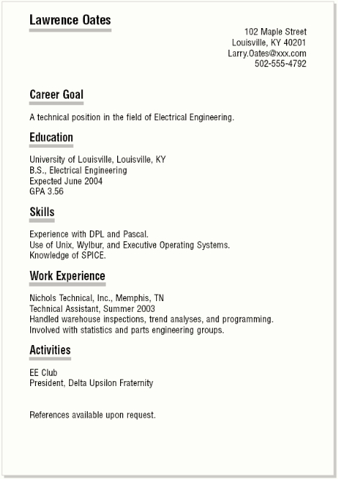
Sample Resume- a good sample

Slide 14
Application, Cover Letter, Resume and Letters of Recommendation
Letters of Recommendation:
Who should they be from?
Who should they be addressed to?
How many do I need?

Slide 15
Social Media
Make it a professional and accurate representation of you
Nice cover photo
No slang
Be cautious of your “friends”
Keep what is public locked down
Keep it current
Be careful regarding what you write or comment about

Slide 16
How to Prepare for Interview
Know your industry
Know your audience
Networking
What is appropriate attire showing up?
What will you be remembered for?
Should bring a cover letter and resume to the Company or Hiring Manager?

Slide 17
First Impressions
Emails
Cell phone
Home phone
Social Media
Dress
Number of times you call

Slide 18
Thank you
Questions?

